Slide 1

The Benefits of Blockchain Supply Chain Management Within Residential Construction

Slide 2


Introduction
Brief History
Platform Approach
The Logbook
Blockchain
Supply Chain
Current Status and Opportunities

Slide 3

Brief History

Slide 4
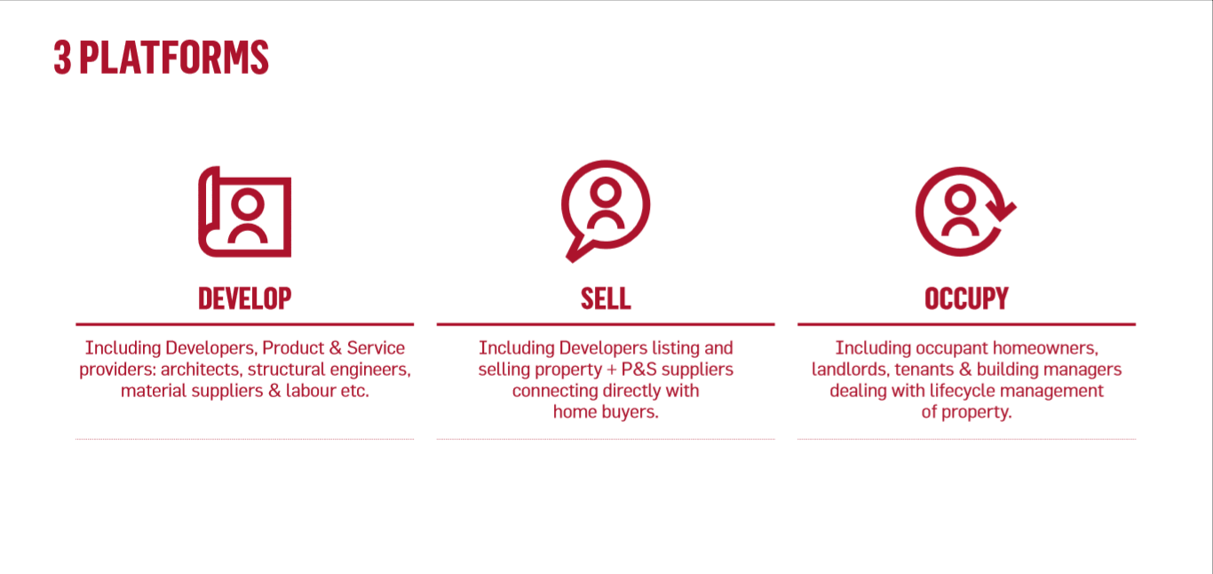
Platform Approach

Slide 5
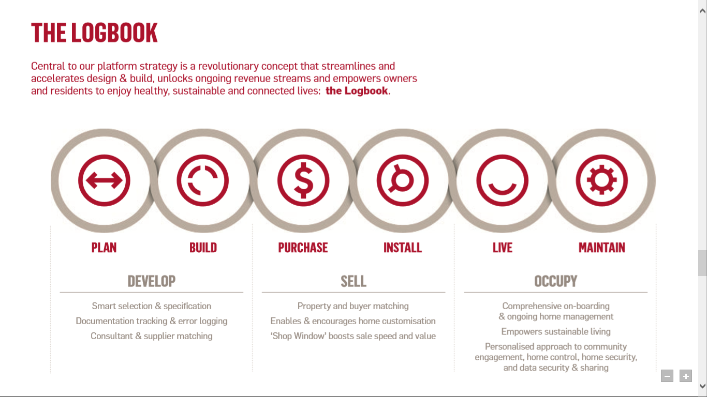
The Logbook

Slide 6

Blockchain

Slide 7

Supply Chain

Slide 8

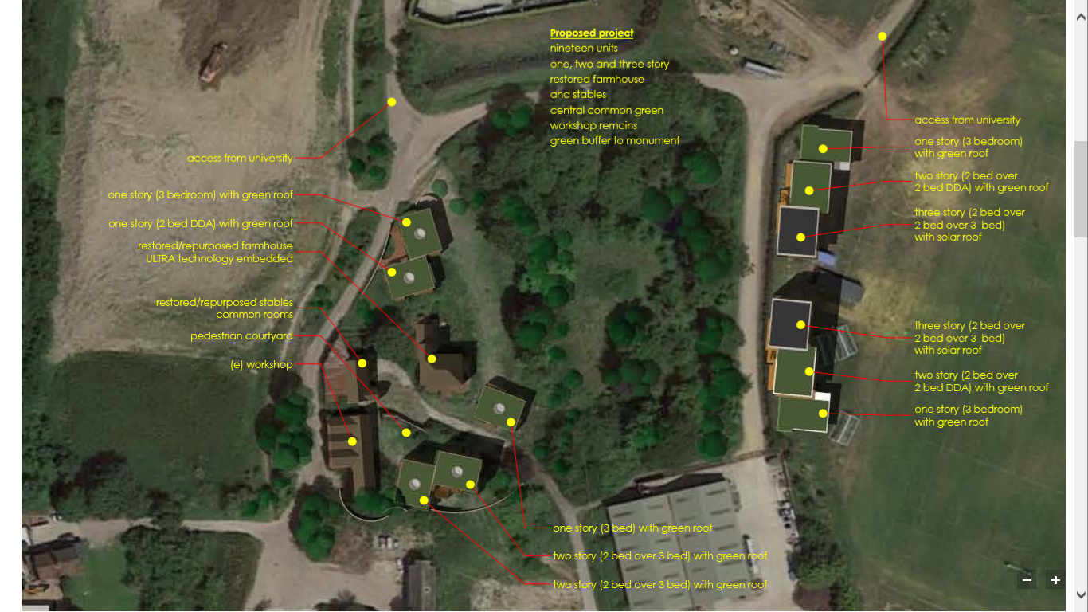
Current Status and Opportunities
Microsite
Innovation Centre

Slide 9
Summary
Brief History
Platform Approach
The Logbook
Blockchain
Supply Chain
Current Status and Opportunities

Slide 10
Dan Eades CTO dan@myglobalhome.co

